Slide 1
Multiple Regression
There are many situations were a single predictor variable in the model would provide an inadequate description since a number of key variables affect the response variable.
Furthermore, in these situations, predictions of the response variable based on a model with only one predictor can be too imprecise to be useful.
For example, suppose we consider weight as a response variable and use height as the sole predictor.
This model would not provide a very good description of the variability in weights and would be a poor method of predicting weight. What else should go in the model?

Slide 2

Multiple Regression
When there are 2 predictor variables X₁ and X₂, the regression model is
Y_{i} denotes the response in the i^{th} trial and X_{i1} and X_{i2} are the values of the predictors in the i^{th} trial. The βs are parameters and ε_{i} are the error terms.
We assume that E{ε_{i}} = 0 and the regression function is
E{Y} = β₀ + β₁X₁ + β₂X₂

Slide 3
Multiple Regression
The parameter β₁ indicates the change in E{Y} per unit increase in X₁ when X₂ is held constant.
Suppose that β₀ = 10, β₁ = 2, and β₂ = 5, and that X₂ is held at the level X₂ = 2. The regression function is then
E{Y} =10 + 2X₁ + 5(2) = 20 + 2X₁
Note that the response function is a straight line with intercept 20 and slope β₁ = 2. For any other value of X₂, only the intercept changes, and the slope is still 2.
Thus β₁ = 2 indicates that E{Y} increases by 2 with a unit increase in X₁ at a fixed level of X₂.

Slide 4
Multiple Regression
Likewise, the parameter β₂ indicates the change in E{Y} per unit increase in X₂ when X₁ is held constant.
Thus β₂ = 5 indicates that E{Y} increases by 5 with a unit increase in X₂ at a fixed level of X₁.
The βs are called partial regression coefficients because they reflect the partial effect of one predictor variable when the other predictor is held constant.

Slide 5
Multiple Regression
When the effects of X₁ on E{Y} does not depend on the level of X₂, and correspondingly the effects of X₂ on E{Y} does not depend on the level of X₁, the two variables are said to have additive effects or no interaction.
Note if the effect of X₁ does not depend on the level of X₂ then the effects of X₂ can not depend on the level of X₁.

Slide 6
Multiple Regression
We now consider the case where there are p-1 predictor variables (so there are p βs including the intercept). The regression model is
Assuming that E{ε_{i}} = 0, the regression function is
E{Y} = β₀ + β₁X₁ + β₂X₂ + ….+ β_{p-1}X_{p-1}

Slide 7
Multiple Regression
The meaning of the parameters is analogous to the case with two predictors. The parameter β_{k} indicates the change in E{Y} per unit increase in X_{k} when all the other predictor variables are held constant.
Note, there is no interaction and this model is additive.
Thus the effect of any predictor variable on E{Y} is the same no matter what the levels of the other variables.

Slide 8
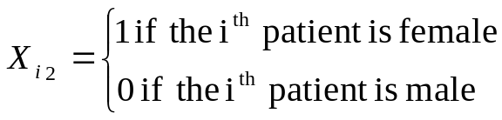

Multiple Regression
We use indicator variables that take on the values 0 and 1 to identify the classes of a qualitative variable.
Consider a regression analysis to predict the length of hospital stay (Y) based on the age (X₁) and gender (X₂) of the patient. We define X₂ as
The regression model is as follows.
where X_{i1} is the i^{th} subject’s age and X_{i2} is as defined above.

Slide 9
Multiple Regression
The regression function is E{Y} = β₀ + β₁X₁ + β₂X₂ and for male patients (where X₂=0) the regression function becomes
E{Y} = β₀ + β₁X₁ (Male Patients)
For female patients (where X₂=1) the regression function becomes
E{Y} = β₀ + β₁X₁ + β₂ = (β₀ + β₂) +β₁X₁ (Female Patients)
These two response functions represent parallel straight lines with different intercepts.
SAS -multiple

Slide 10


Multiple Regression
Polynomial regression models contain squared and higher-order terms of a predictor variable, making the response curvilinear, such as the quadratic model we saw earlier.
This is a linear model because it is linear in the βs. We can define X_{i1} as X_{i} and X_{i2} as X_{i}² and write the model as

Slide 11
Multiple Regression
Interaction between two predictor variables is entered into a model as the cross -product of those two variables.
Interaction: The effect that one variable has on the response variable depends on the value of another variable.
For example, the effect that age has on blood pressure may depend on diet (good or bad). This is an age by diet interaction. If someone is on a good diet, perhaps the effect of age on blood pressure is not as strong as the effect of age for someone who is on a bad diet.

Slide 12
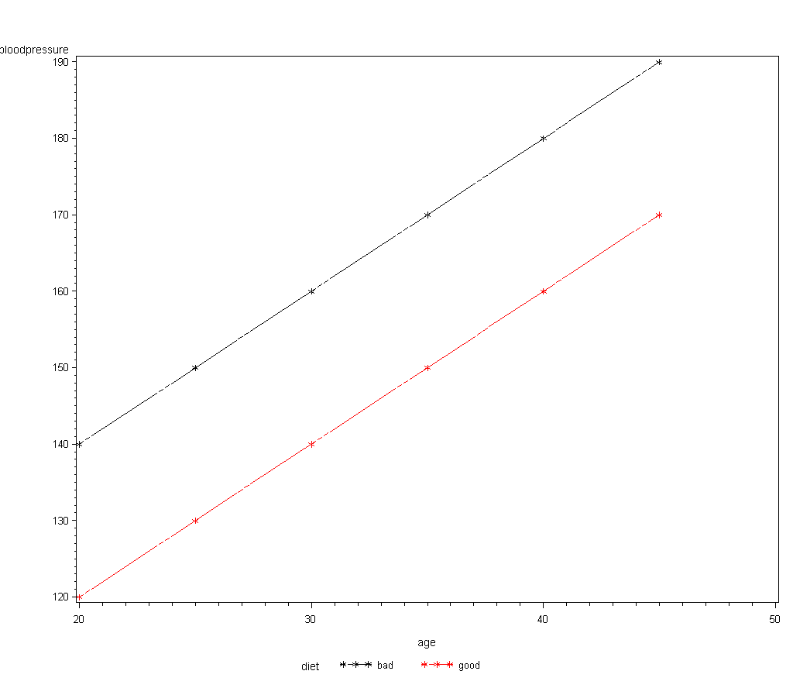
Multiple Regression
First, consider a case with where both age and diet have an effect on blood pressure but there is no interaction.
It is clear that subjects on a good diet have lower blood pressures and that as age goes up so does blood pressure. The rate that blood pressure goes up is the same regardless of the type of diet. Thus the effect of age is the same for both diets.

Slide 13
Multiple Regression
Also, the effect of diet type is the same regardless of age. The mean blood pressure for good diet is 20 below the mean blood pressure for bad diet, at every age.

Slide 14
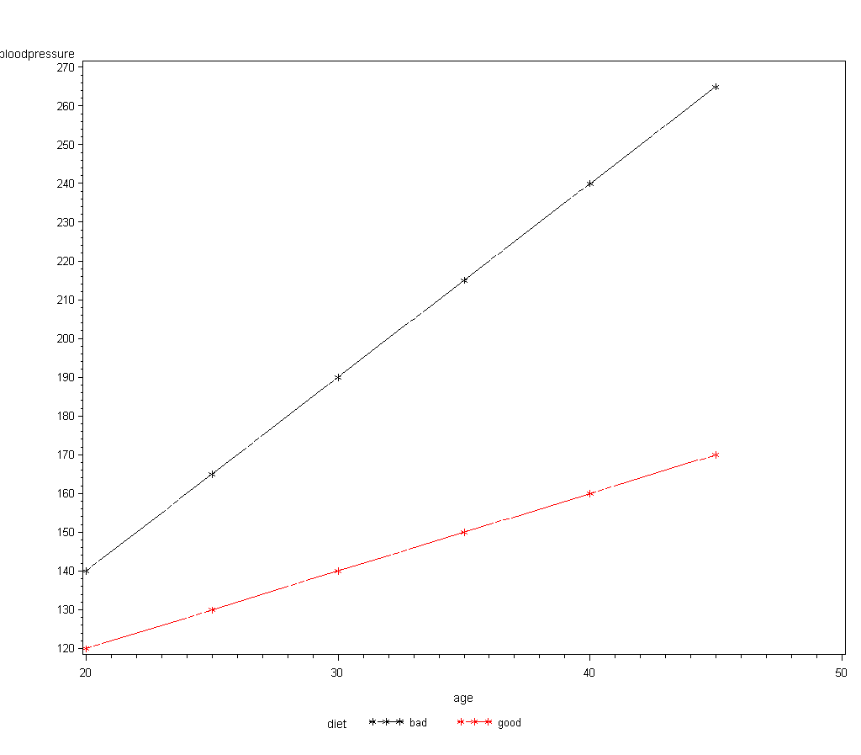
Multiple Regression
Now, consider a case with where both age and diet have an effect on blood pressure but there is interaction.
We still have that subjects on a good diet have lower blood pressures and that as age goes up so does blood pressure. But now, the rate that blood pressure goes up for those on a bad diet is much steeper. Thus the effect of age depends on diet.

Slide 15
Multiple Regression
Now, consider a case with where both age and diet have an effect on blood pressure but there is interaction.
Also, when age is low, the diets are close together, but when age is large, the diets are far apart. Thus the effect of diet depends on age.

Slide 16
Multiple Regression
An example of a regression model with interaction between X₁ and X₂ is
Note that the interaction term between X₁ and X₂ is simply the cross-product of the two.
As a result, this can lead to strong correlation between either X₁, X₂ , or both and the cross-product term X₁X₂.
This correlation can cause problems and one remedy is to center the variables X₁ and X₂ which we will see later.

Slide 17
Multiple Regression
For the blood pressure example, the model with interaction between age and diet is
where Diet = 1 if subject i is on a good diet and 0 if on a bad diet.
With interaction in the model, the interpretation of the Betas is different. Here
β₁ is the slope with respect to age for subjects on a bad diet.
β₁ + β₃ is the slope with respect to age for subjects on a good diet. Thus β₃ is the difference in the slopes for subjects on a good diet or a bad diet.
So if β₃ is 0, the slopes with respect to age for both diets is the same. That is, there is no diet by age interaction.

Slide 18
Multiple Regression
β₂ is the difference in intercepts which is the difference between good and bad diets when age is 0. So if β₂ is 0, then there is no difference between the diet types at age 0.
This might not be meaningful but we can make it meaningful. We can define age* as the age minus the mean age, that is age*= age – mean(age).
If we then use age* in the model in place of age, β₂ is now the difference between good and bad diets when age* is 0.
Note, when age* = 0, we have that age*= age – mean(age) = 0 and thus age=mean(age). Thus when we use age* in the model in place of age, β₂ is the difference between good and bad diets at the mean age.

Slide 19
Multiple Regression
Now, β₂ is the difference between good and bad diets when age* is 0 (which is when age = the mean age).
Thus testing if β₂ is 0 with age* in the model corresponds to testing if there is a difference between the diet types at the mean age.
Note, when using this model, the age in the interaction term also needs to be transformed to age*.
We can also test if there is a difference between diets at other ages. For instance, to test if there is a difference between diets at 65, we would use age** = age – 65 in the model in place of age. SAS: interaction_cat_cont

